Slide 1
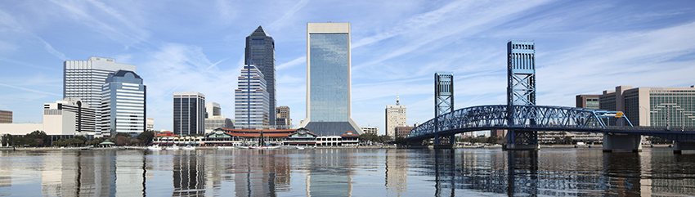
Amsterdam Data Challenge
April 6th 2017, De Zuiderkerk

Slide 2
Schedule
9:30-10:00 Reception
10:00-10:30 Presentation of the case
10:30-12:30 Work
12:30-13:15 Lunch
13:15-16:30 More work
16:30-17:15 Presentations
17:15-17:30 ADC
18:00 Dinner & Borrel

Slide 3
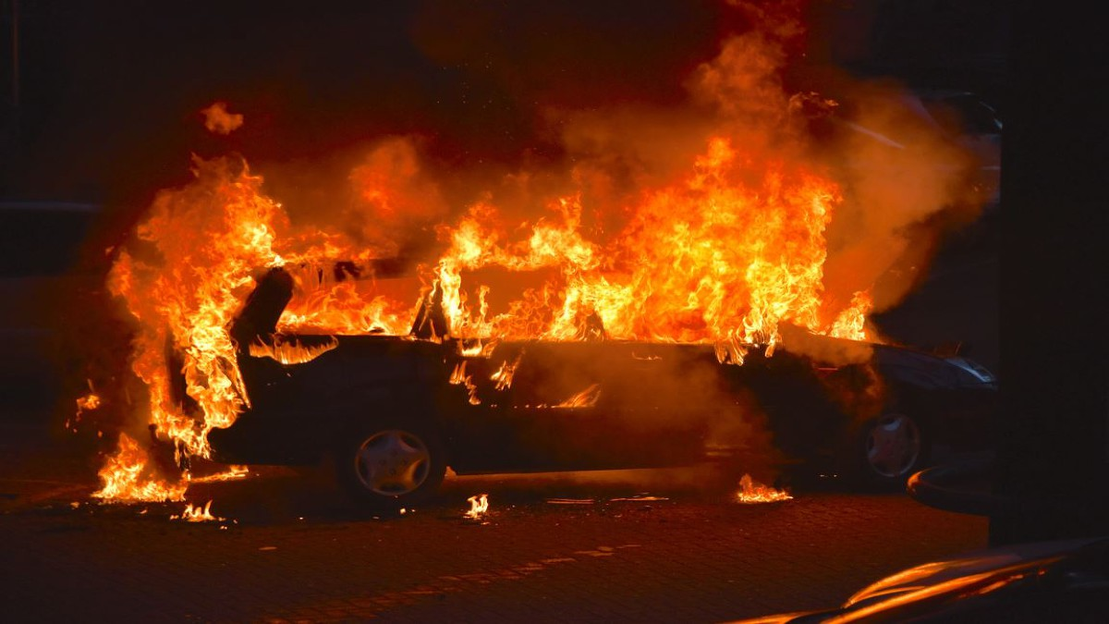
Introduction
Murder most foul!

Slide 4
Introduction
Investigative Journalist, Rutger Castricum, found dead in burnt car
Rental car was found burning in a parking lot next to the Vondelpark in Amsterdam
Burning is estimated to have occurred in the night between March 14th and 15th
The body of the victim was found in the trunk of the car

Slide 5
Introduction
Investigative Journalist, Rutger Castricum, found dead in burnt car
Reporter was known to be investigating a possible corruption charge of a leading politician, but it is unknown which politician it was.
Presence of car at DWDD studio during the political debate leads to suspecting all party leaders.

Slide 6
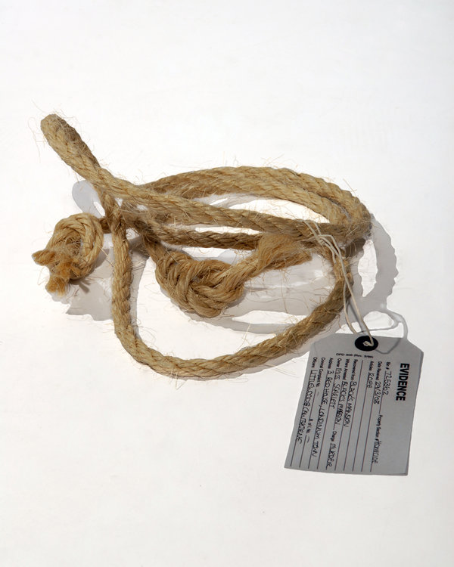
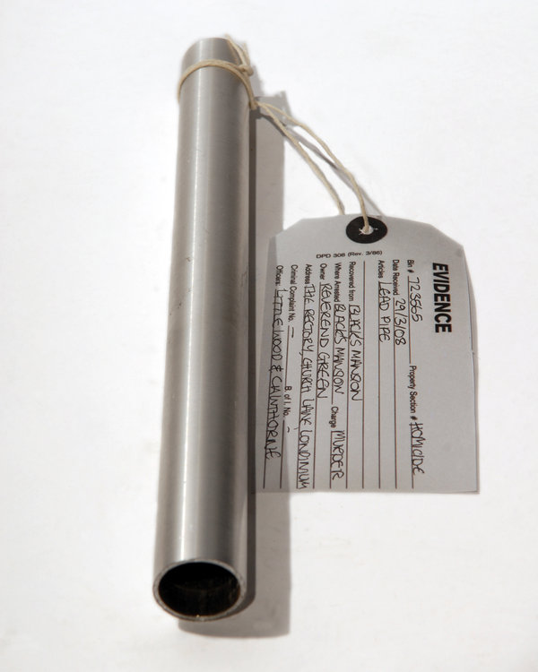
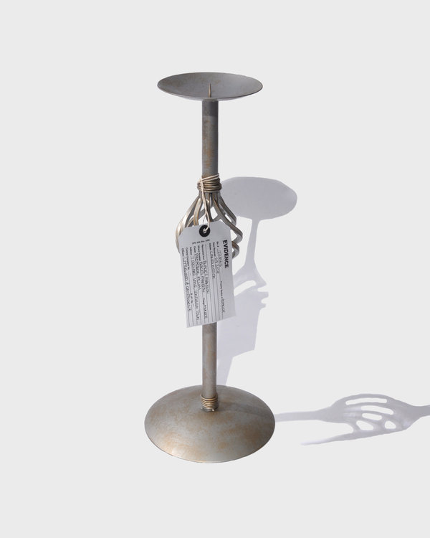
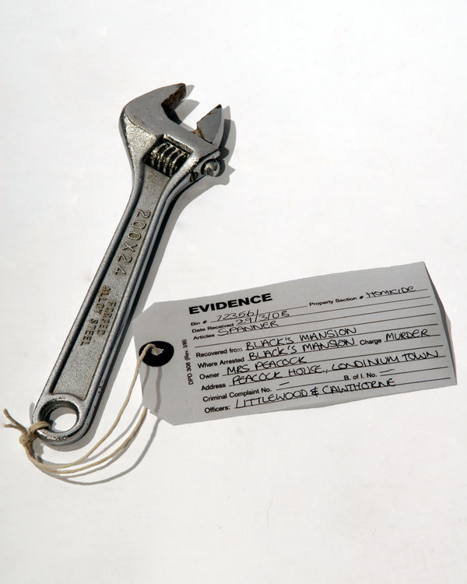
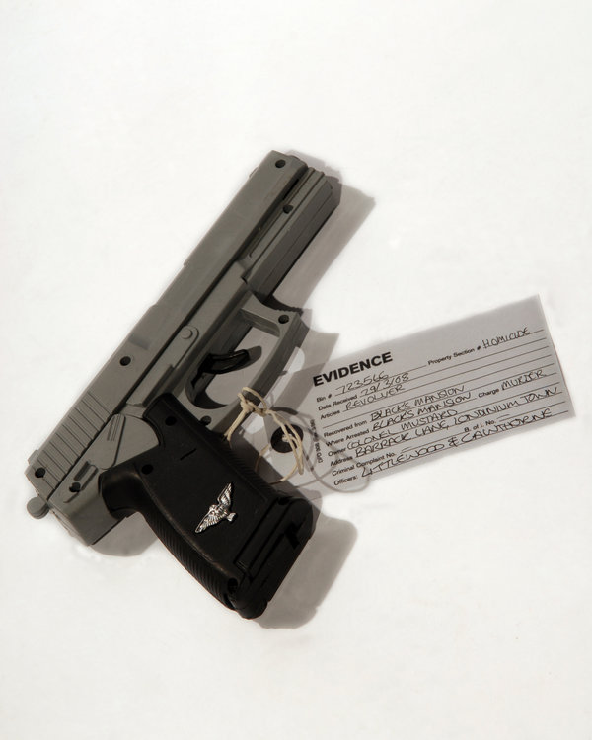
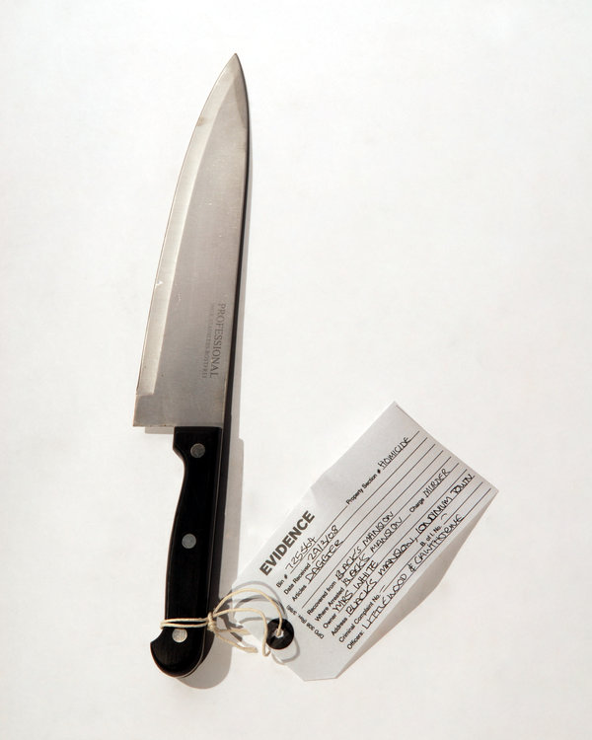
Introduction
Found around the murder scene

Slide 7
Introduction
The five Ws
How (murder weapon)
Where (location of murder)
When (time of murder)
Who (‘dunnit)
Why (what is the motive)

Slide 8
Introduction
End goal
Present your case, proving:
Means (the ability of the defendant to commit the crime)
Motive (the reason the defendant committed the crime)
Opportunity (whether the defendant had the chance to commit the crime)

Slide 9
Data Sets
murderdata.csv and weapondata.csv
Two samples were found on the victim, containing different levels of the following chemical components RI, Al, Mn, Pb, Si, K, Cu, Ag, Fe. The measurment can be found in murderdata.csv
(weapondata.csv) Chemical samples of various murder weapons in previous crimes seen by the Amsterdam Police Department, including “Type” – the type of the murder weapon.
Train a prediction model on weapondata.csv and use this to predict the most likely murder weapon(s) in the two samples

Slide 10
Data Sets
GPSdata.csv
The burnt car had an accelerometer which contains driving history of times, longitudes and latitudes.

Slide 11
Data Sets
112Calls.csv
The police department supplied us with the log of emergency calls in the days around the murder, containing dates, times, latitudes (N-degree), longitudes (E-degree) and the emergency type.

Slide 12
Data Sets
PhoneData.csv
Information about phone history of the leading suspects (party leaders) was found, containing id (name), type, longitude, latitude and time of the call/txt.
Use PhoneData.R to go trough this file.

Slide 13
Data Sets
Tweets
Tweets of all Dutch politics party leaders (the suspects)
Use Sentiment.R to read the data and run sentiment analysis (it will load the necessary data and tools if you keep all files in the same folder).

Slide 14
Final tips
Bear in mind that different steps in your investigation lead to new insight. For example: you may first need to know Who did it before you can find out Why he/she did it…
Keep all files in the same folder and open RStudio by opening one of the R scripts is this folder. This way your working directory will be setup in the right way.

Slide 15
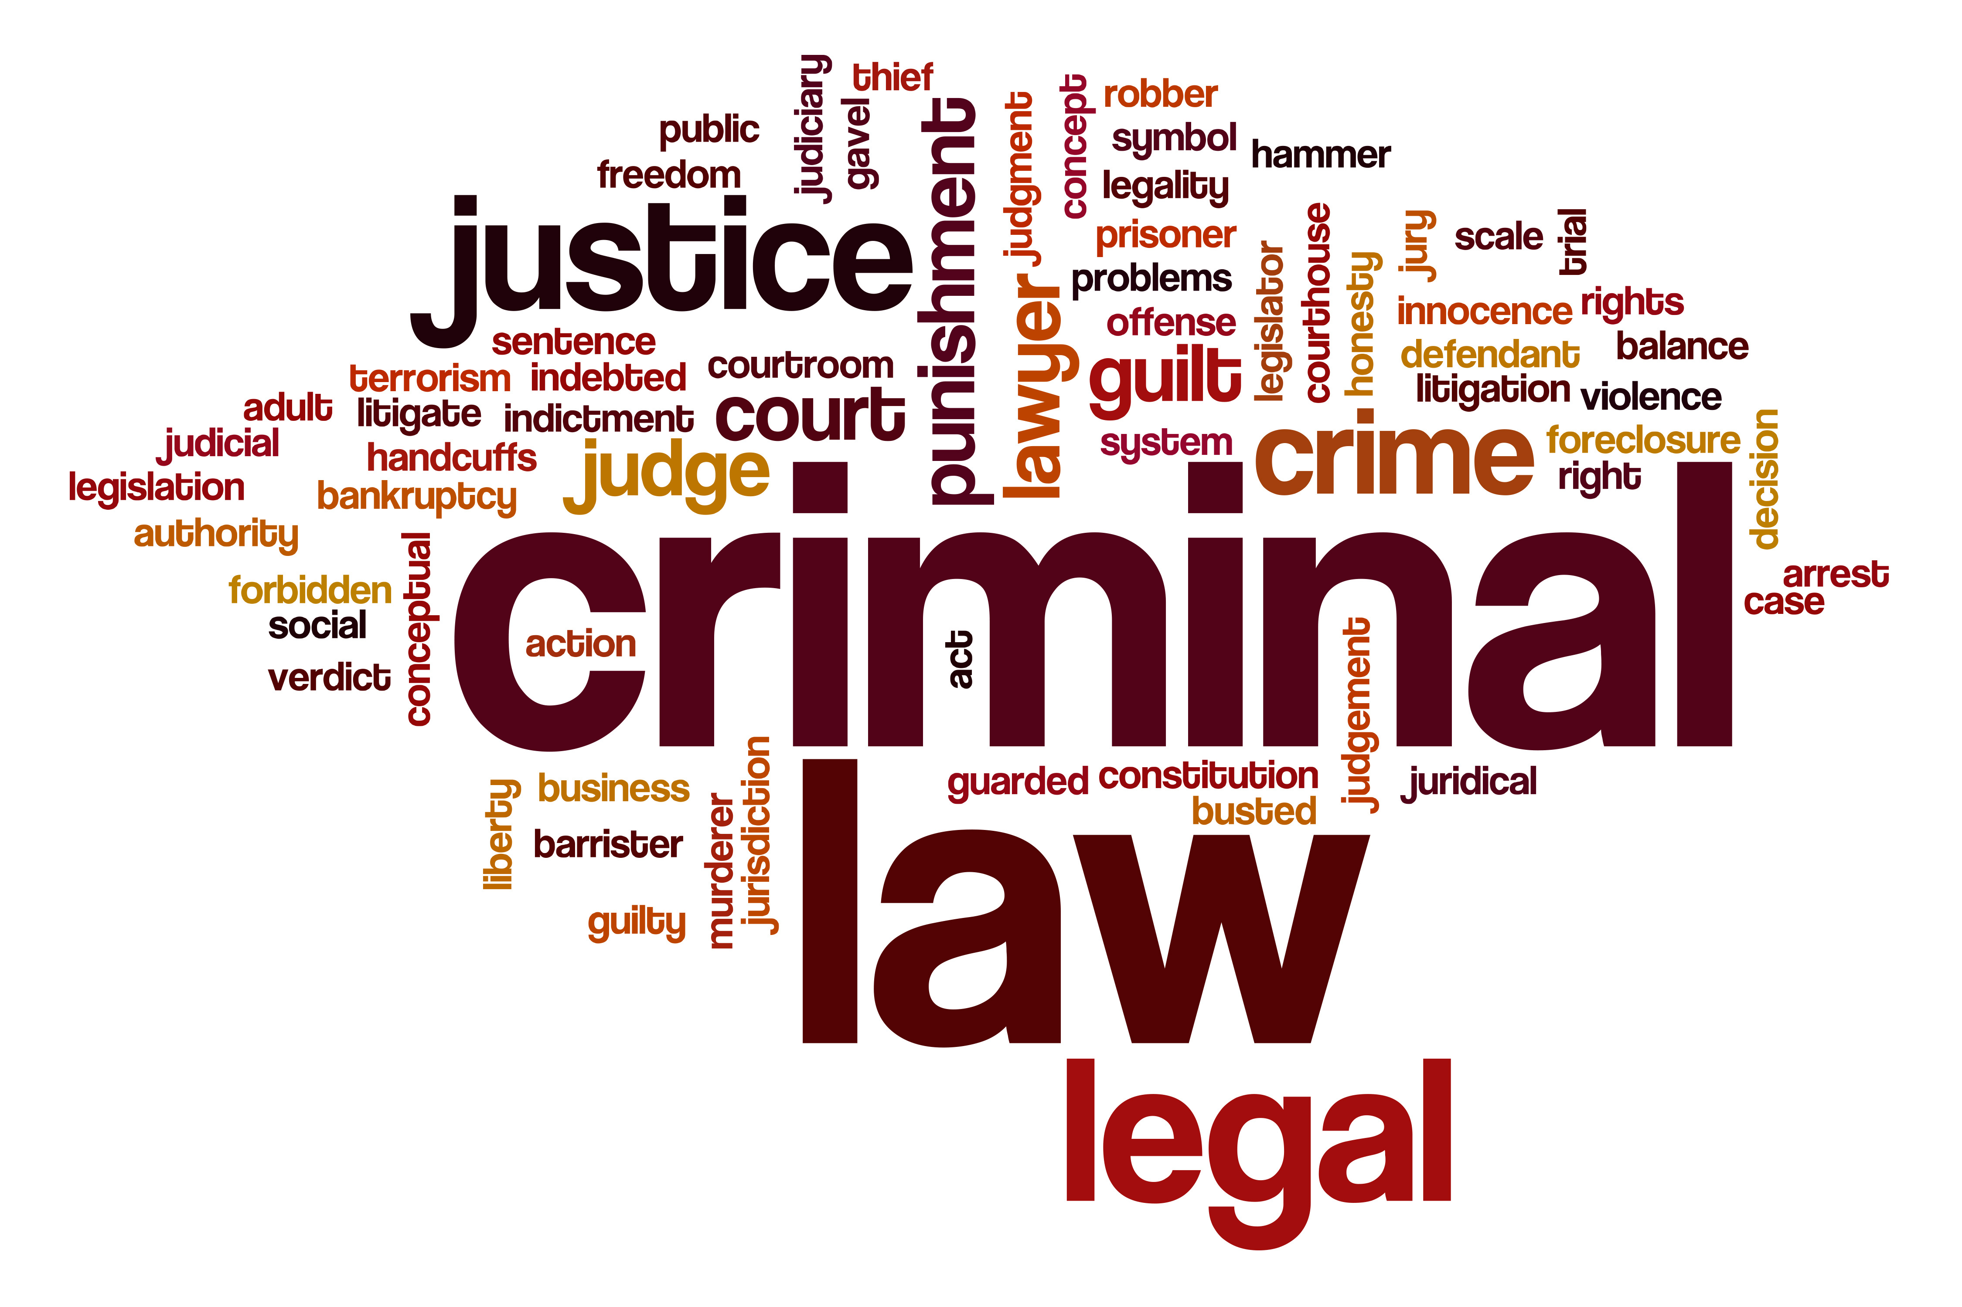
Get detecting!

